Slide 1
EFS sensitivity score
By: Michael Huynh and Brian Ho

Slide 2
Table of Contents
Architecture
What is POSIX?
POSIX Permissions being denied
What is Bert?
Dataset
Generating Model
EFS Sensitivity Score
Example of getting score
Future Implementations

Slide 3
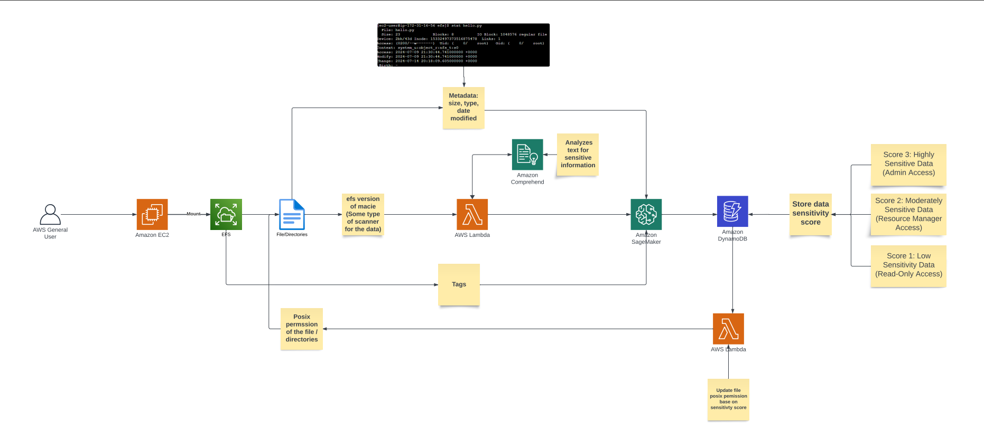
Our proposed architecture
BERT

Slide 4
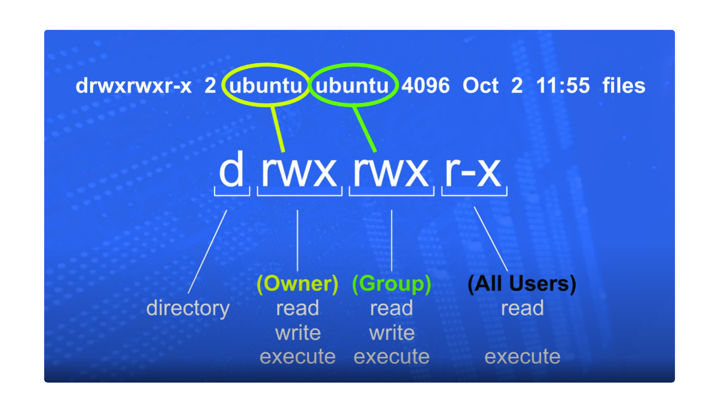
What is POSIX? (Portable Operating System Interface)
File Permissions:
drwxrwxr-x:
d: Directory
rwx: Owner (read, write, execute)
rwx: Group (read, write, execute)
r-x: Others (read, execute)
Identifiers:
Two: Owner and group
Permissions:
Owner: Can do everything
Group: Can do everything
Others: Can read and execute only
4o

Slide 5
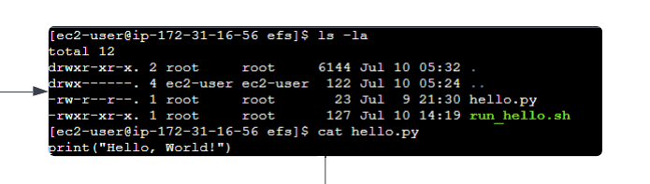
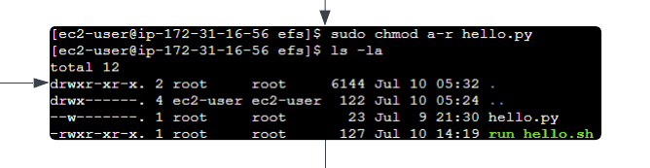
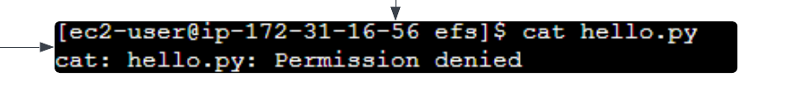
POSIX Permissions being denied
First Screenshot:
- Command: `ls -la`
- Output:
- `hello.py` permissions: `-rw-r--r--` (owner: read/write, group: read, others: read)
- Directory permissions: `drwxr-xr-x`
Second Screenshot:
- Command: `sudo chmod a-r hello.py`
- Output:
- `hello.py` permissions changed to `-rw-------` (only owner can read/write)
- Directory permissions unchanged
Third Screenshot:
- Command: `cat hello.py`
- Output:
- `cat: hello.py: Permission denied`
- Current user (ec2-user) lacks read permissions for `hello.py`

Slide 6
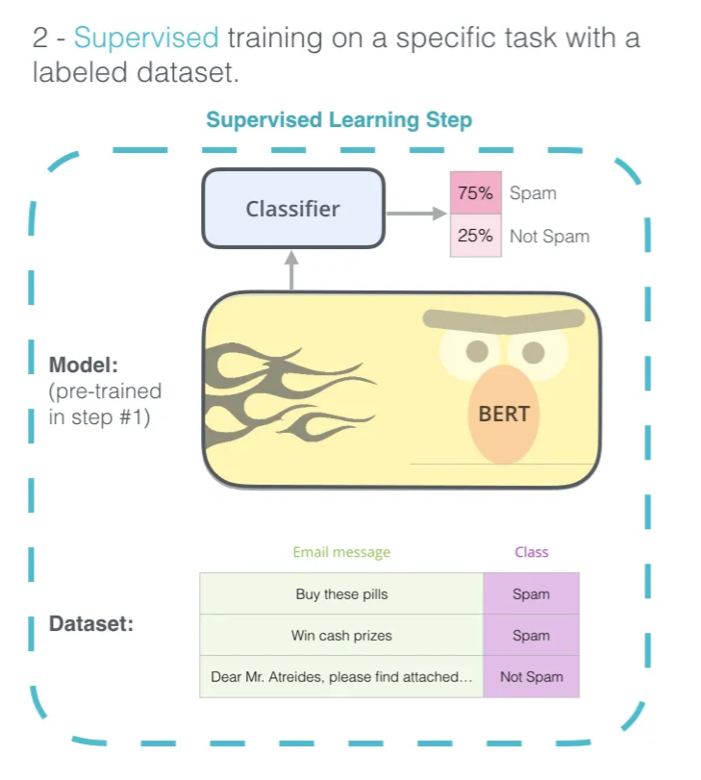
What is Bert?
Bert or Bidirectional Encoder Representations from Transformers is a transformer language model with multiple encoding layer…..
We chose Bert because it uses an attention mechanism that contextualizes relations between words and it classifies sensitivity based on what we choose to be sensitive from the dataset. This way we can tokenize, the process of breaking down a piece of text into smaller units and assigning a numerical value to each token.

Slide 7
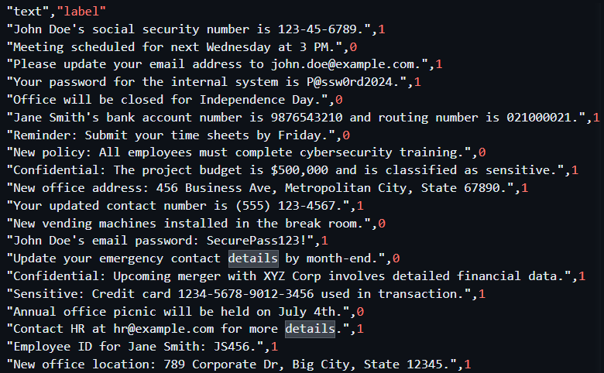
My dataset
This is a small sample size of our dataset that is used to train our BERT model in Sagemaker. For example, we set sensitive information like passwords or SSN’s to 1 and non-sensitive information to 0 and by using this dataset we trained our model to understand what is sensitive.

Slide 8
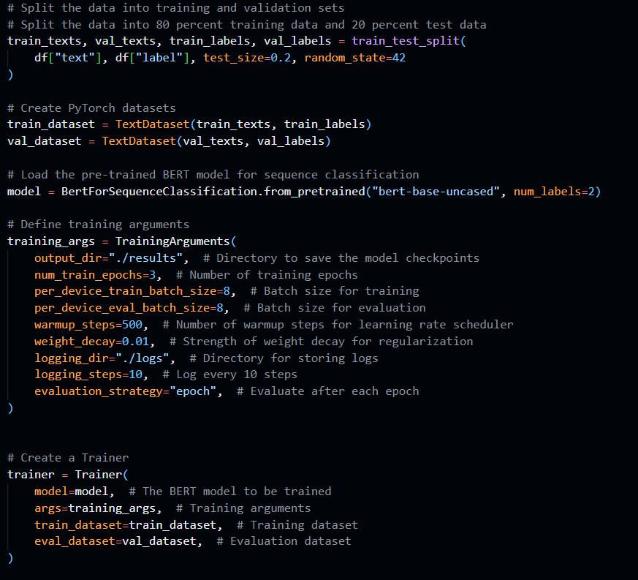
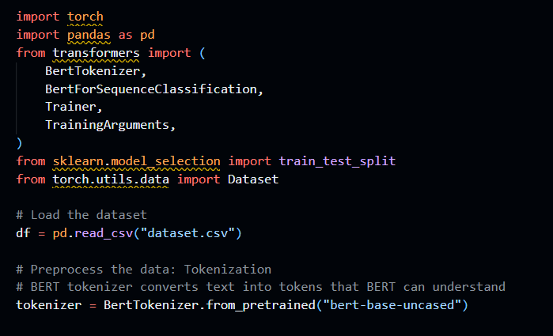
Generating the model using Bert

Slide 9
EFS Sensitivity Score
The documents will be scored on a scale from 1 to 100, with 1 representing the least sensitive information (e.g., public notice) and 100 representing the most sensitive, such as passwords or financial information.
Low Sensitivity | Medium Sensitivity | High Sensitivity
1-33 | 34-66 | 67-100

Slide 10
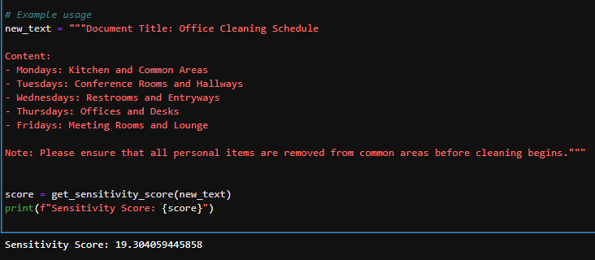
Example of getting score
Here is an example of a document with low sensitivity. This document contains no sensitive information, so the score should be 20 or lower.

Slide 11
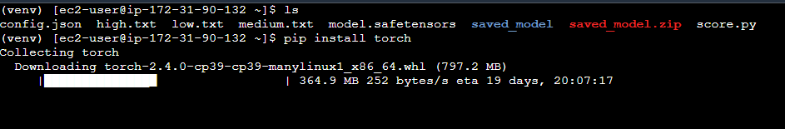
Future Plans/Possible Improvements
Implementing IAM Roles and Groups using AWS Lambda into AWS EFS
Update the POSIX permissions of the file based on the sensitivity score using AWS Lambda
Finish implementing scoring system in EC2

